Slide 1
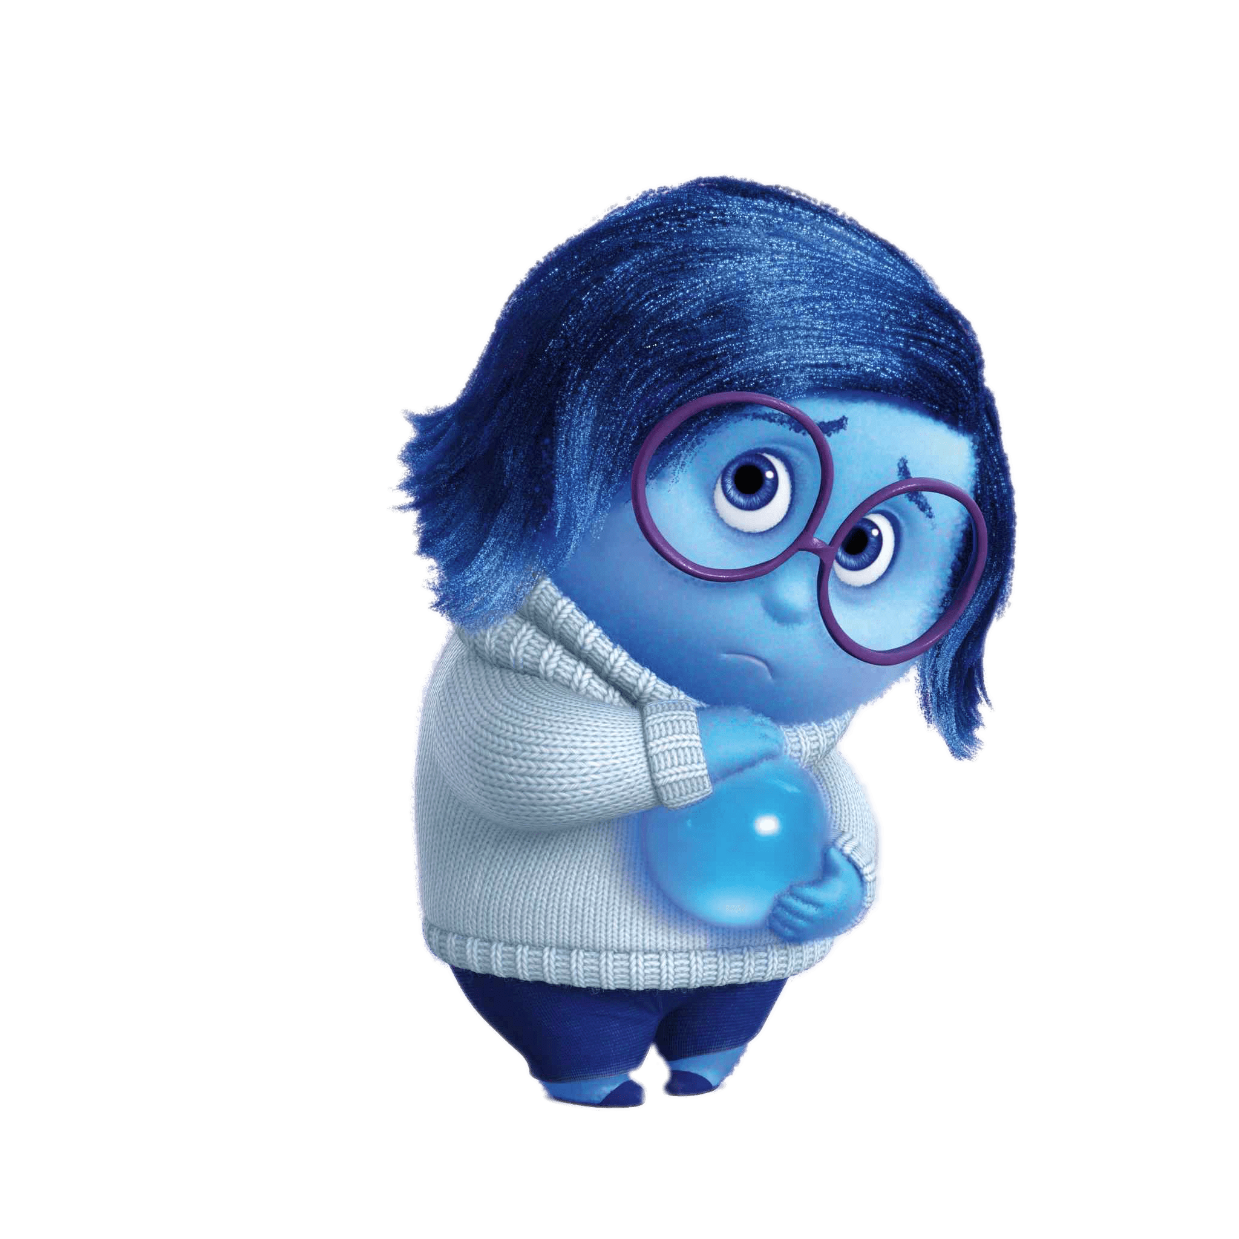

Emotion Detection
Chatbot
GROUP DSA_202101_ 4

Slide 2
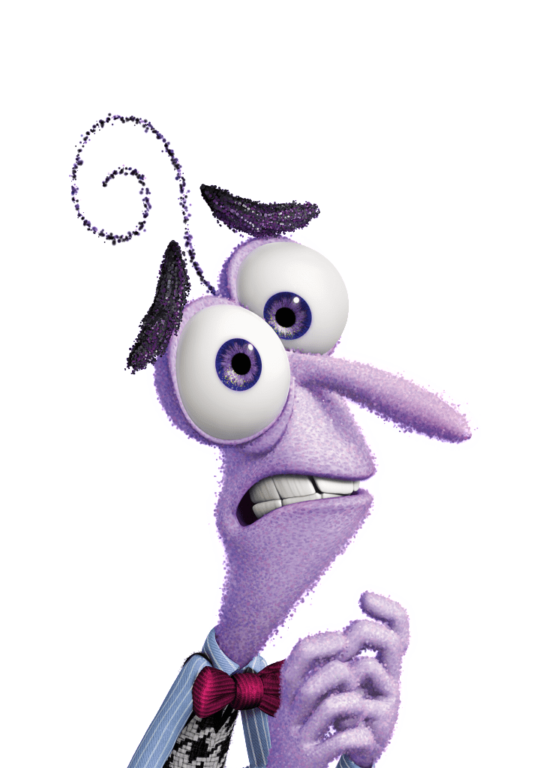

Depression is one of the leading causes of disability.
Suicide is the fourth leading cause of death among 15-29-year-olds

Slide 3
Most common techniques to improve Mental Health
listening to a song
Appeal to your senses
Talk to someone
without judgment

Slide 4
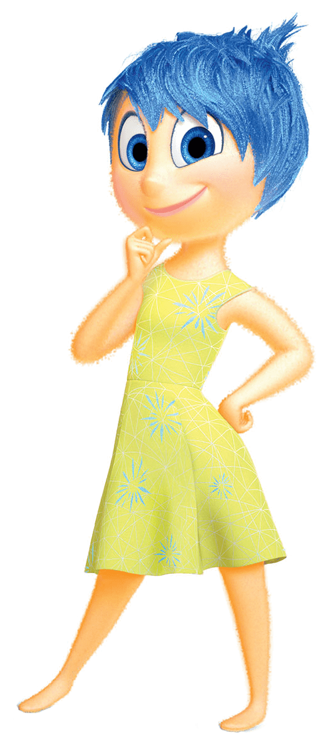
While listening to music that you know and like tends to cause the strongest brain response and dopamine release.

Slide 5
Project Goal
Develop a chatbot that detects emotions

Slide 6
Project Goal
Develop a chatbot that detects emotions
and based on these emotions, the chatbot generate
customize response to enhance
mental health for users
and recommend a song for them.

Slide 7

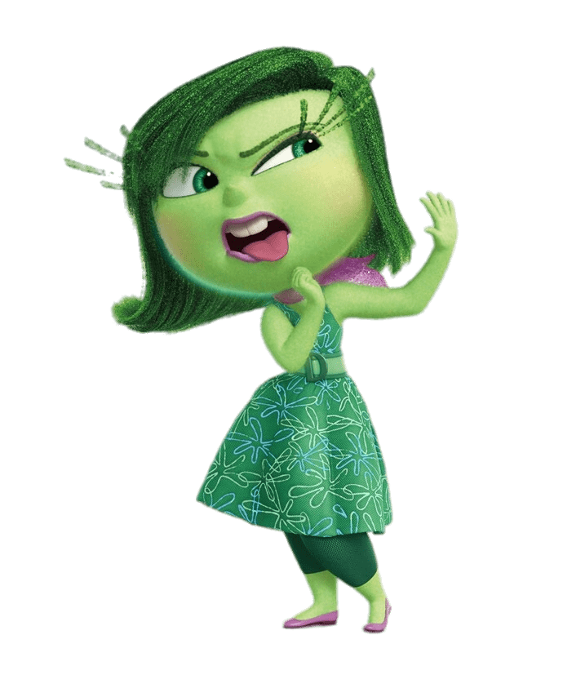
Methodology
Dataset
Text files
Six features
love
joy
surprise
sadness
fear
anger

Slide 8
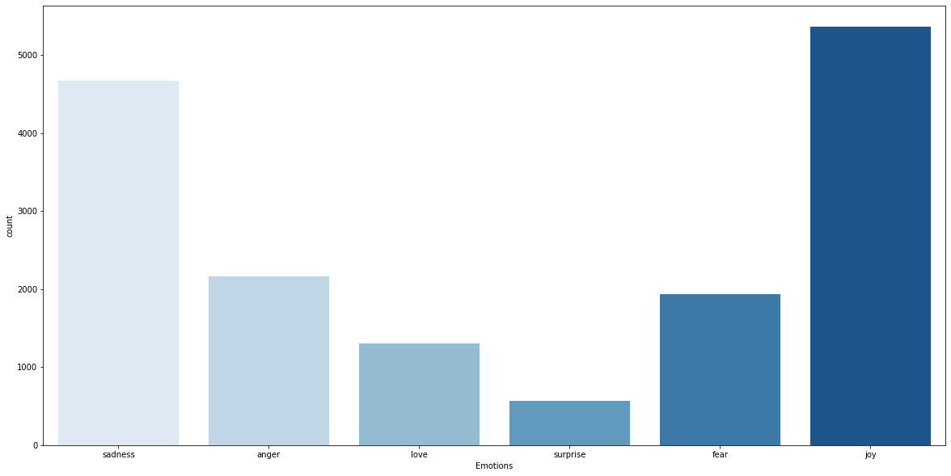
Methodology
love
joy
surprise
sadness
fear
anger
Dataset
Text files
Six features

Slide 9
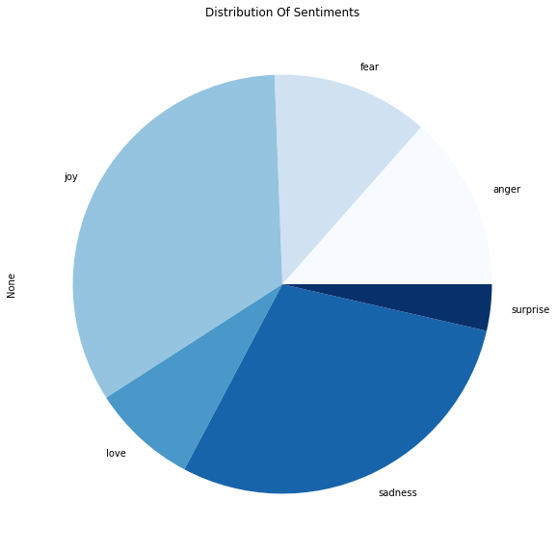
Methodology
love
joy
surprise
sadness
fear
anger
Dataset
Text files
Six features

Slide 10
Methodology
Dataset
Sentiment analysis
Text files
love
joy
surprise
Part 1: sentiment analysis methods with classification algorithms
SVM
KNN
Naive Bayes
Logistic regression
Part 2: sentiment analysis methods with clustering algorithms .
kmean
sadness
fear
anger

Slide 11
Methodology
classification algorithms
Dataset
Sentiment analysis
Text files
love
joy
surprise
Support Vector Machines
K-Nearest Neighbors
Naive Bayes
Logistic Regression
sadness
fear
80 %
45 %
70 %
89 %
anger

Slide 12
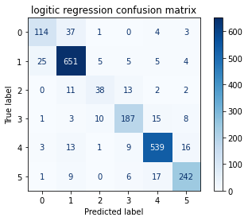
Methodology
classification algorithms
Dataset
Sentiment analysis
Text files
Logistic Regression
love
joy
surprise
89 %
sadness
fear
anger

Slide 13
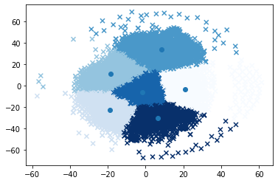
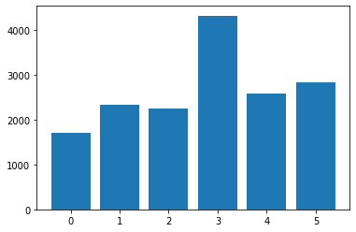
Methodology
clustering algorithms
KMeans

Slide 14
Methodology
clustering algorithms
KMeans

Slide 15
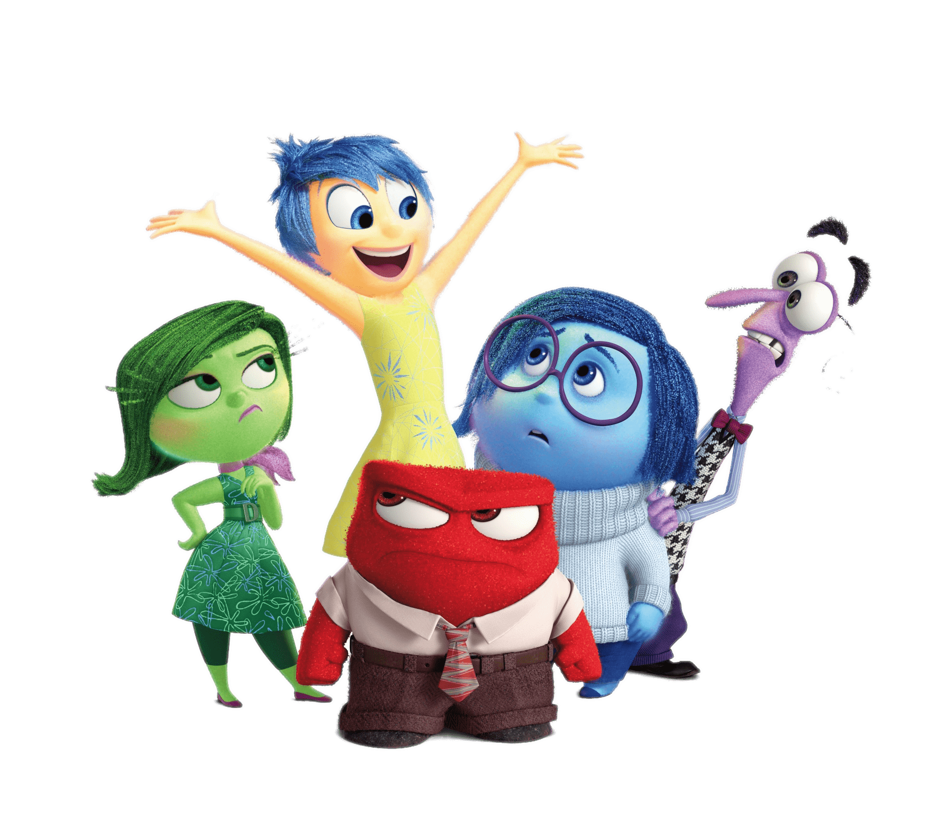
Recommendation system for music based on emotions

Slide 16
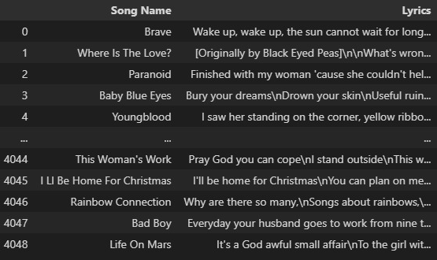
Recommendation system for music based on emotions
1. Dataset with lyrics
2. Use pretrained model to predict probabilities for emotion of each song

Slide 17
Integration

Slide 18
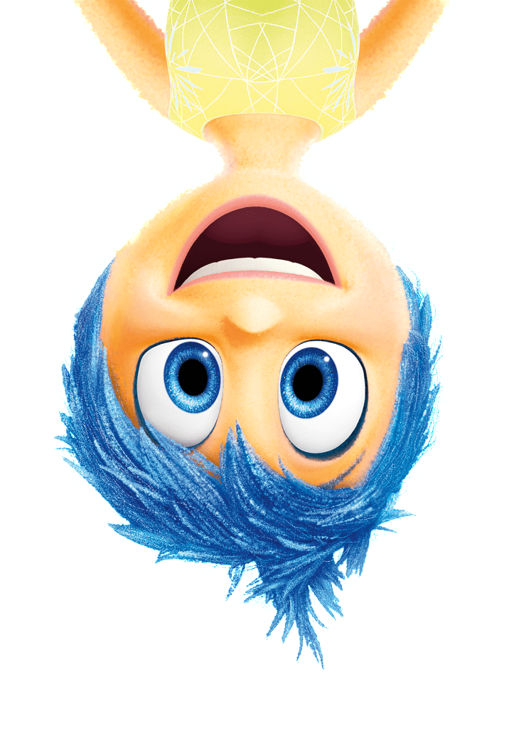
Model
User input
Choose the most close music for user current mode by using cosine similarity
Input
Model
Emotion proba
Detect emotion probabilities for input
Textual input
Suggested song
Output

Slide 19
THANK YOU !
Do you have any questions?

